Slide 1
Using Google Speech Recognizer with Android
By Mark Hardiman

Slide 2
API Usage Preliminary Steps
Enable recording and internet permissions
In the project manifest:
<uses-permission android:name="android.permission.INTERNET" />
<uses-permission android:name="android.permission.RECORD_AUDIO" />

Slide 3
API Usage Setup the intent
Determine the speech recognition settings by setting up an intent
Choose language model
Free form
General usage
Web search
Used for shorter phrases
IETF language tag (e.g., en-US)
Hands-free mode
Trigger a web search
Intent intent = new Intent(RecognizerIntent.ACTION_RECOGNIZE_SPEECH);
intent.putExtra(RecognizerIntent.EXTRA_LANGUAGE_MODEL,
RecognizerIntent.LANGUAGE_MODEL_FREE_FORM);

Slide 4
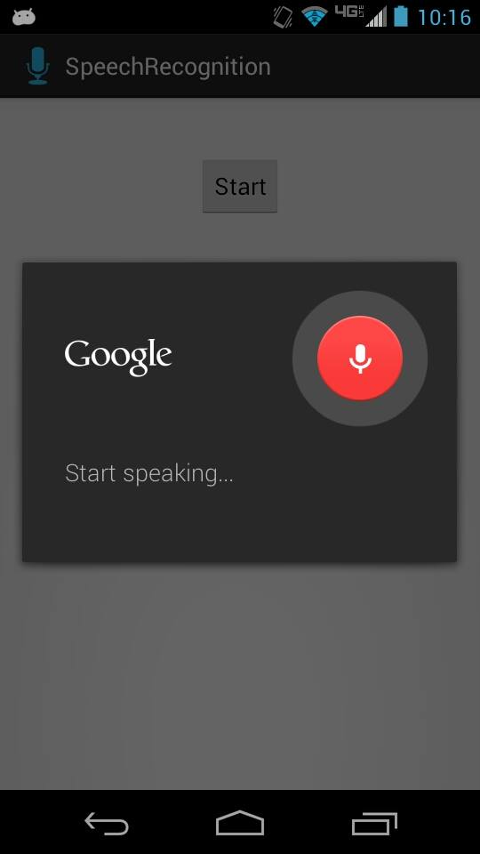
API Usage Method 1
Start an activity using the intent and the RecognizerIntent class
Easier
Pre-made visual interface
Default settings
Auto-detect voice for start/stop
Hidden
startActivityForResult(intent, REQUEST_CODE);
…
protected void onActivityResult(int requestCode, int resultCode, Intent data) {
…

Slide 5
API Usage Method 2
Manually control the recognition process from within the same activity using SpeechRecognizer, RecognitionListener, and RecognizerIntent
Must implement the RecognitionListener class
More robust
Allows for easier debugging
Greater complexity
Optional manual control over various processes
SpeechRecognizer speechRec = SpeechRecognizer.createSpeechRecognizer(this);
MyRecognitionListener listener = new MyRecognitionListener();
speechRec.setRecognitionListener(listener);
speechRec.startListening(intent);
…
class MyRecognitionListener implements RecognitionListener { …

Slide 6
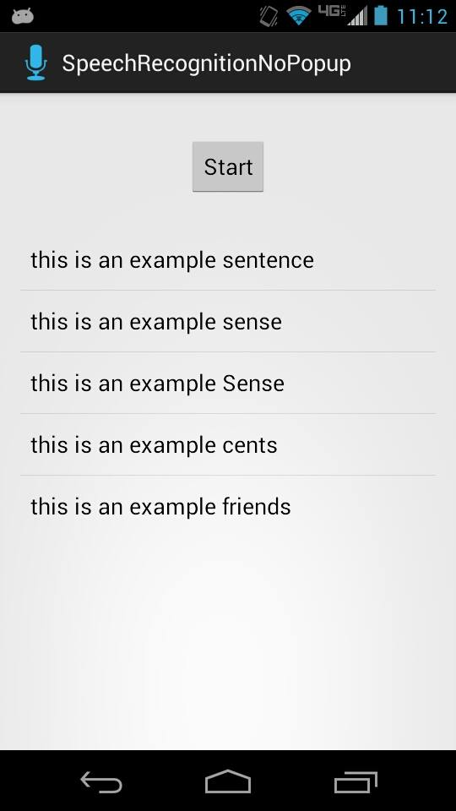
Example

Slide 7
Resources
http://androidbite.blogspot.com/2013/04/android-voice-recognition-example.html
http://developer.android.com/reference/android/speech/package-summary.html
https://code.google.com/p/my-work-and-play-android/source/browse/trunk/android/speech/SpeechRecognizer/SpeechRecognizer/src/com/SpeechRecognizer/SpeechRecognizerActivity.java

Slide 8
Questions?

